Slide 1

Voice of Customers
Sentiment Analysis using NLP

Slide 2
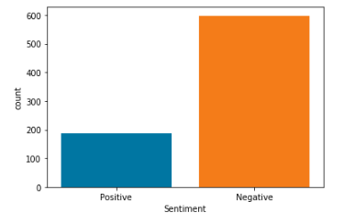
Voice Of Customer
Voice of Customer refers to review comments on the customer facing application. Based on the experience of the users with the application, we are going to design a model to predict the review comments are positively or negatively polarized
Review Comments from Play Store has been extracted using Web Scrapping for Fly Delta and Air Canada Application
Total Number of Records Used – 785

Slide 3
Text Preprocessing
Removing stop words
Removing punctuation
Removing extra spaces
Removing digits
Normalizing the words by lemmatization
Stripping the sentence
Lowering the sentences
Taking the individual the words as features as ng-grams 1-1

Slide 4

Machine Learning Approaches & Results

Slide 5
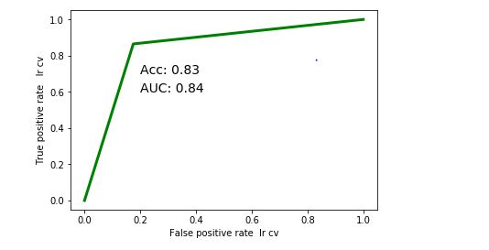
Logistic Regression – Count Vectorizer
Logistic Regression is a Predictive Analysis that can be used when the target variable is Binary.
The CountVectorizer provides a simple way to both tokenize a collection of text documents and build a vocabulary of known words, but also to encode new documents using that vocabulary.
Accuracy is 83.44%
Classification Report | Precision | Recall | F1 – Score | Support
0 | 0.95 | 0.82 | 0.88 | 120
1 | 0.60 | 0.86 | 0.71 | 37
Accuracy |  |  | 0.83 | 157
Macro Avg | 0.78 | 0.84 | 0.80 | 157
Weighted Avg | 0.87 | 0.83 | 0.84 | 157
AUC | 0.844932432432432

Slide 6
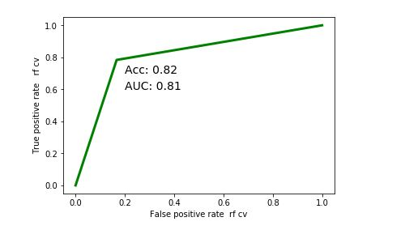
Random Forest – Count Vectorizer
Random forest consists of a large number of individual decision trees that operate as an ensemble. Each individual tree in the random forest spits out a class prediction and the class with the most votes becomes our model’s prediction
The CountVectorizer provides a simple way to both tokenize a collection of text documents and build a vocabulary of known words, but also to encode new documents using that vocabulary.
Accuracy is 82.17%
Classification Report | Precision | Recall | F1 – Score | Support
0 | 0.93 | 0.83 | 0.88 | 120
1 | 0.59 | 0.78 | 0.67 | 37
Accuracy |  |  | 0.82 | 157
Macro Avg | 0.76 | 0.81 | 0.78 | 157
Weighted Avg | 0.85 | 0.82 | 0.83 | 157
AUC | 0.808558558558558

Slide 7
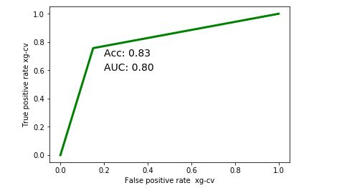
XG Boost– Count Vectorizer
XGBoost is an optimized gradient boosting algorithm through parallel processing, handling missing values and and regularization to avoid overfitting and bias
The CountVectorizer provides a simple way to both tokenize a collection of text documents and build a vocabulary of known words, but also to encode new documents using that vocabulary.
Accuracy is 82.8%
Classification Report | Precision | Recall | F1 – Score | Support
0 | 0.92 | 0.85 | 0.88 | 120
1 | 0.61 | 0.76 | 0.67 | 37
Accuracy |  |  | 0.83 | 157
Macro Avg | 0.76 | 0.80 | 0.78 | 157
Weighted Avg | 0.85 | 0.83 | 0.83 | 157
AUC | 0.8033783

Slide 8
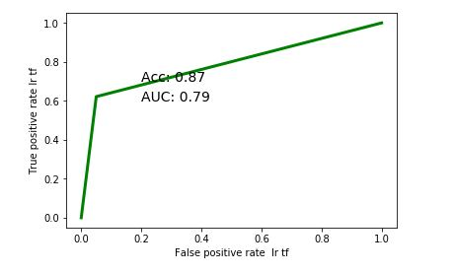
Logistic Regression – TFIDF Vectorizer
Logistic Regression is a Predictive Analysis that can be used when the target variable is Binary.
TfidfVectorizer - Transforms text to feature vectors that can be used as input to estimator
Accuracy is 87.26%
Classification Report | Precision | Recall | F1 – Score | Support
0 | 0.89 | 0.95 | 0.92 | 120
1 | 0.79 | 0.62 | 0.70 | 37
Accuracy |  |  | 0.87 | 157
Macro Avg | 0.84 | 0.79 | 0.81 | 157
Weighted Avg | 0.87 | 0.87 | 0.87 | 157
AUC | 0.78581081081081

Slide 9
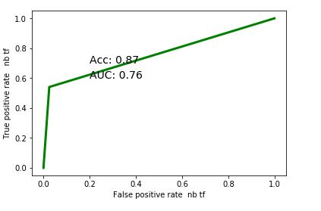
Naïve Bayes – TFIDF Vectorizer
Naive Bayes is a classification algorithm for binary (two-class) and multi-class classification problems. Instead of calculating the value for each attribute, it assumed to be conditionally independent given the target value.
TFIDF Vectorizer - Transforms text to feature vectors that can be used as input to estimator
Accuracy is 87.26%
Classification Report | Precision | Recall | F1 – Score | Support
0 | 0.87 | 0.97 | 0.92 | 120
1 | 0.87 | 0.54 | 0.67 | 37
Accuracy |  |  | 0.87 | 157
Macro Avg | 0.87 | 0.76 | 0.79 | 157
Weighted Avg | 0.87 | 0.87 | 0.86 | 157
AUC | 0.757770270

Slide 10
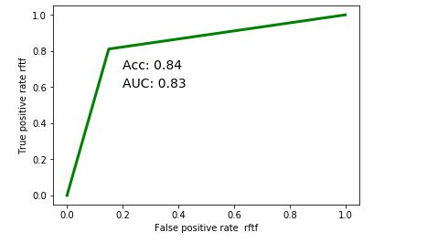
Random Forest – TFIDF Vectorizer
Random forest consists of a large number of individual decision trees that operate as an ensemble. Each individual tree in the random forest spits out a class prediction and the class with the most votes becomes our model’s prediction
TFIDF Vectorizer - Transforms text to feature vectors that can be used as input to estimator
Accuracy is 82.17%
Classification Report | Precision | Recall | F1 – Score | Support
0 | 0.94 | 0.85 | 0.89 | 120
1 | 0.62 | 0.81 | 0.71 | 37
Accuracy |  |  | 0.84 | 157
Macro Avg | 0.78 | 0.83 | 0.80 | 157
Weighted Avg | 0.86 | 0.84 | 0.85 | 157
AUC | 0.830405

Slide 11
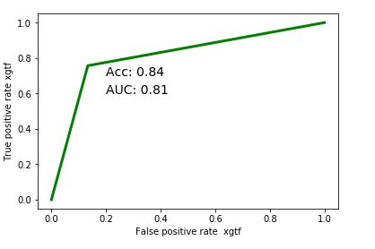
XG Boost– TFIDF Vectorizer
XGBoost is an optimized gradient boosting algorithm through parallel processing, handling missing values and and regularization to avoid overfitting and bias
TFIDF Vectorizer - Transforms text to feature vectors that can be used as input to estimator
Accuracy is 84.08%
Classification Report | Precision | Recall | F1 – Score | Support
0 | 0.92 | 0.87 | 0.89 | 120
1 | 0.61 | 0.76 | 0.69 | 37
Accuracy |  |  | 0.84 | 157
Macro Avg | 0.78 | 0.81 | 0.79 | 157
Weighted Avg | 0.85 | 0.84 | 0.85 | 157
AUC | 0.811711

Slide 12
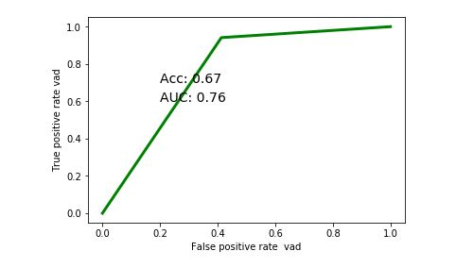
Lexicon Model - Vader
A lexicon model typically uses a lexicon, also known as a dictionary or vocabulary of words specifically aligned to sentiment analysis. It can be used to compute the sentiment of a text document by matching the presence of specific words from the lexicon and then looking at other factors like presence of negation parameters, surrounding words, overall context, phrases, and aggregate overall sentiment polarity scores to decide the final sentiment score
The VADER lexicon is based on a rule-based sentiment analysis framework, specifically tuned to analyze sentiments
Accuracy is 67.13%
Classification Report | Precision | Recall | F1 – Score | Support
0 | 0.97 | 0.59 | 0.73 | 598
1 | 0.42 | 0.94 | 0.58 | 187
Accuracy |  |  | 0.67 | 785
Macro Avg | 0.69 | 0.76 | 0.65 | 785
Weighted Avg | 0.84 | 0.67 | 0.69 | 785
AUC | 0.764066496

Slide 13
Deep Learning Approach

Slide 14
Text Preprocessing
Removing the digits
Removing the puncutation,single char, alpha num,non ascii
Tokenizing the reviews and padding the reviews as the sequences and taking the max length 250 of the text by taking the median of the text length in the train data
Choosing the pretrained model glove with the words of 100dimension vectors

Slide 15
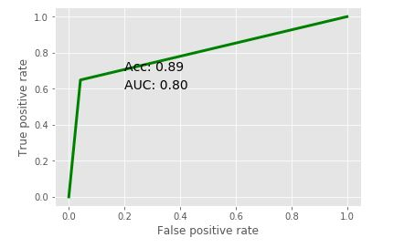
Bi Directional LSTM
Bidirectional LSTM means the Data propagates backward as well as forward in time. Feed the learning algorithm with the original data once from beginning to the end and once from end to beginning. Hence It learns faster than one-directional approach
Accuracy is 88.54%
Classification Report | Precision | Recall | F1 – Score | Support
0 | 0.90 | 0.96 | 0.93 | 120
1 | 0.83 | 0.65 | 0.73 | 37
Accuracy |  |  | 0.89 | 157
Macro Avg | 0.86 | 0.80 | 0.83 | 157
Weighted Avg | 0.88 | 0.89 | 0.88 | 157
AUC | 0.803490

Slide 16
Conclusion
From various Machine Learning Models, Naïve Bayes has been finalized for the below reasons,
Model is predicting less number of False positives (i.e predicting Negative sentiment as Positive) than other models.
It has good accuracy and AUC Score
Bidirectional LSTM has been finalized for sentiment Analysis for the below reasons,
It has good accuracy and AUC Score
As the data propagation flow is from past to future and future to past, it will learn about the data completely better than other model.

Slide 17

Thank you

